Slide 1


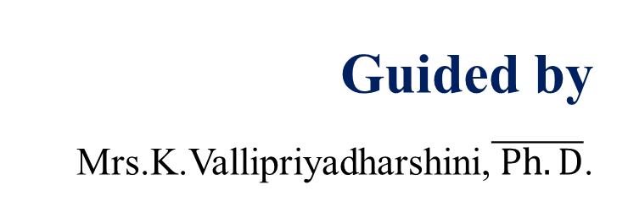
K.RAMAKRISHNAN COLLEGE OF TECHNOLOGY (AUTONOMOUS), TRICHY An Efficient Deep Learning-Based System for Accurate Plant Leaf Disease Detection and Remedial Measures
PRESENTED BY
811719104064 - Pradeep Kumar S
811719104092 - Shri Vishnu P
811719104095 - Somasundaram S
Guided by
Mrs.K.Vallipriyadharshini,$\overline{ Ph.D}$.

Slide 2
PROBLEM IDENTIFICATION
Traditional methods for detecting plant diseases often rely on visual inspection by trained professionals, which can be time-consuming, costly, and prone to human error.
Inaccurate or delayed diagnosis of plant diseases can result in reduced crop yield and quality, as well as increased use of pesticides and other resources.
Existing machine learning-based approaches for plant disease detection may suffer from limited accuracy or scalability, particularly when dealing with large datasets or complex disease symptoms.
There is a need for a more efficient, reliable, and automated system for plant disease detection that can provide accurate diagnoses and actionable remedial measures to farmers and agricultural experts.

Slide 3
OBJECTIVE
To detect unhealthy regions of plant leaves.
Classification of plant leaf diseases using texture features.
To analyse the leaf infection.
To give remedy information to the user.
To make this services available on Web App which can run on low level configuration devices.

Slide 4
ABSTRACT
Plant Disease Prediction is an application which will detect and provide some remedial measures for diseases in the crop to the users.
Initially the client can either click or upload the image of the diseased crop in the application.
Once the plant disease is matched with the existing data, then the effective remedial measures such as what action should take about the disease is provided.
The image is processed for the effective remedial measures using the Convolutional Neural Network (CNN) Algorithm.

Slide 5
INTRODUCTION
Agricultural sector holds a vital role in the Indian economy by contributing 18.8% in India’s total GDP.
Potato plants covers 33% total vegetable production of India.
These production can be affected by different diseases.
Misidentification of leaf disease in the agricultural crop can lead to improper or misuse of insecticides and pesticides , causing loss of the crop, increase in pathogen resistance and environmental effect.
Machine learning technique has been used to tackle this problem.

Slide 6
EXISTING SYSTEM
Many existing plant disease detection systems rely on manual visual inspection by human experts, which can be time-consuming and expensive.
Some machine learning-based approaches have been developed for plant disease detection, but these may suffer from limited accuracy, scalability, or generalizability to new datasets or diseases.
Some systems may rely on hand-crafted features or shallow learning models, which may not be able to capture the complex and subtle symptoms of plant diseases.
Some systems may also require specialized hardware or software, making them less accessible to farmers or other stakeholders in the agricultural industry.

Slide 7
DISADVANTAGES OF EXISTING SYSTEM
Some machine learning-based approaches may suffer from limited accuracy, scalability, or generalizability to new datasets or diseases.
Some systems may require specialized hardware or software, making them less accessible to farmers or other stakeholders in the agricultural industry.
Some systems may also rely on hand-crafted features or shallow learning models, which may not be able to capture the complex and subtle symptoms of plant diseases.
Some systems may require high-resolution images or high-quality sensors, which may not be available or affordable in certain regions or contexts.

Slide 8
BASE PAPER
Title | Source | Year | Techniques | Merits | Demerits
Plant Disease Detection and Classification by Deep Learning | https://ieeexplore.ieee.org/abstract/document/9399342 | 2021 | Convolutional neural network models | Modeling complex processes and performing pattern recognition in applications with large amount of data | The entire photographic material included solely images in experimental (laboratory) setups, not in real conditions in the cultivation field

Slide 9
LITERATURE SURVEY
Title | Source | Year | Techniques | Merits | Demerits
Plant disease leaf image segmentation based on super pixel clustering and EM algorithm | Google Scholar: Zhang, S.,You, Z., & Wu, X. | 2019 | EM Algorithm and neural computing and applications | Accuracy is about 90% and has high practical value for plant disease detection. | It does not provide any expert’s advice for remedial measures about the diseases
Image based tomato leaves diseases detection using deep learning | Google Scholar:Ashqar, B. A., & AbuNAser S.S. | 2018 | Convolution Neural Network (CNN) | Accuracy is about 80% on finding the crop diseases. | Implementation is based on the online. No remedial measures are suggested for the diseases.
Using deep learning image based plant disease detection. | Google Scholar Ferentinous, K.P. | 2018 | Convolutional Neural Network and Pattern recognition | It is very useful advisory or early warning tool to operate in cultivation. Accuracy is about 95% | It does not provide any remedial measures to the user.

Slide 10
PROPOSED SYSTEM
Problem:
The current way of detecting plant diseases is not accurate and doesn't provide adequate measures for infected plant leaves
Proposed solution:
Create a web app with an improved system using machine learning. The system will be trained and tested using jupyter notebook.
The web app will classify plant diseases and display information about the disease and remedial measures from a website.

Slide 11
FLOW CHART
Health/Diseased Image
Cache and Shuffle
Resize and Rescaling
Data Augmentation
Activation - Softmax
Flattening
Pooling - MaxPooling
CNN Algorithm
Optimizer - Adam
Metric - Accuracy
Testing
Training
Deployment
Predicted Results

Slide 12






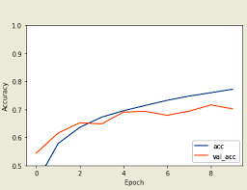
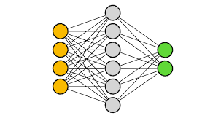
DESIGN DIAGRAM
user
Load the image dataset
Processing the image for use
Importing TensorFlow libraries and transfer learning model
Configure the training model using python
Install the app in android phone
Export the model as TensorFlow lite and build the app using android studio
Test the accuracy of the training model
CNN training model

Slide 13
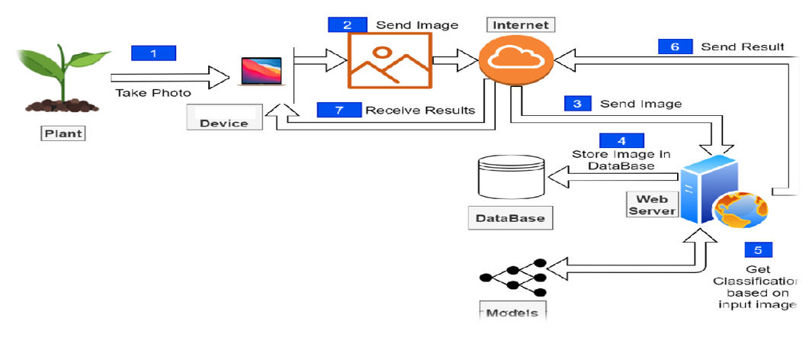
ARCHITECTURE

Slide 14
MODULES
Pre-processing – Performed Split, Cache, Shuffle techniques to the Dataset to achieve speed and accuracy
Segmentation – Dividing the dataset into training, testing, and validation sets
Feature extraction – Color and texture features are extracted from the leaf images
Feature selection – Selecting the most important features from the extracted features using filter methods
DL Algorithm - CNN is used to classify images of plant leaves as healthy or diseased
Evaluation - ROC curve and Metric – accuracy
Final Prediction - Predict whether an input image of a plant leaf is healthy or diseased

Slide 15
Process involved in CNN algorithm
Data preprocessing - Preprocess the dataset of images of plant leaves
Convolution matrix - To detect specific features in the image, edges, textures
Activation – Softmax - Convert the output of the convolutional layer into a probability distribution over the possible classes
Pooling – MaxPooling - Reduce overfitting and improve the performance of the model.
Repeat convolution – Activation – Pooling - Extract higher-level features from the input image.
Flattening - Output is flattened into a one-dimensional vector
Back propagation - Minimize the error between the predicted and actual classes.

Slide 16
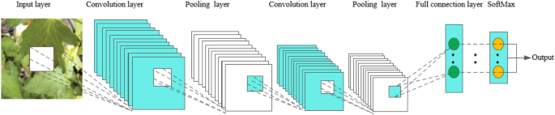
CNN algorithm process

Slide 17
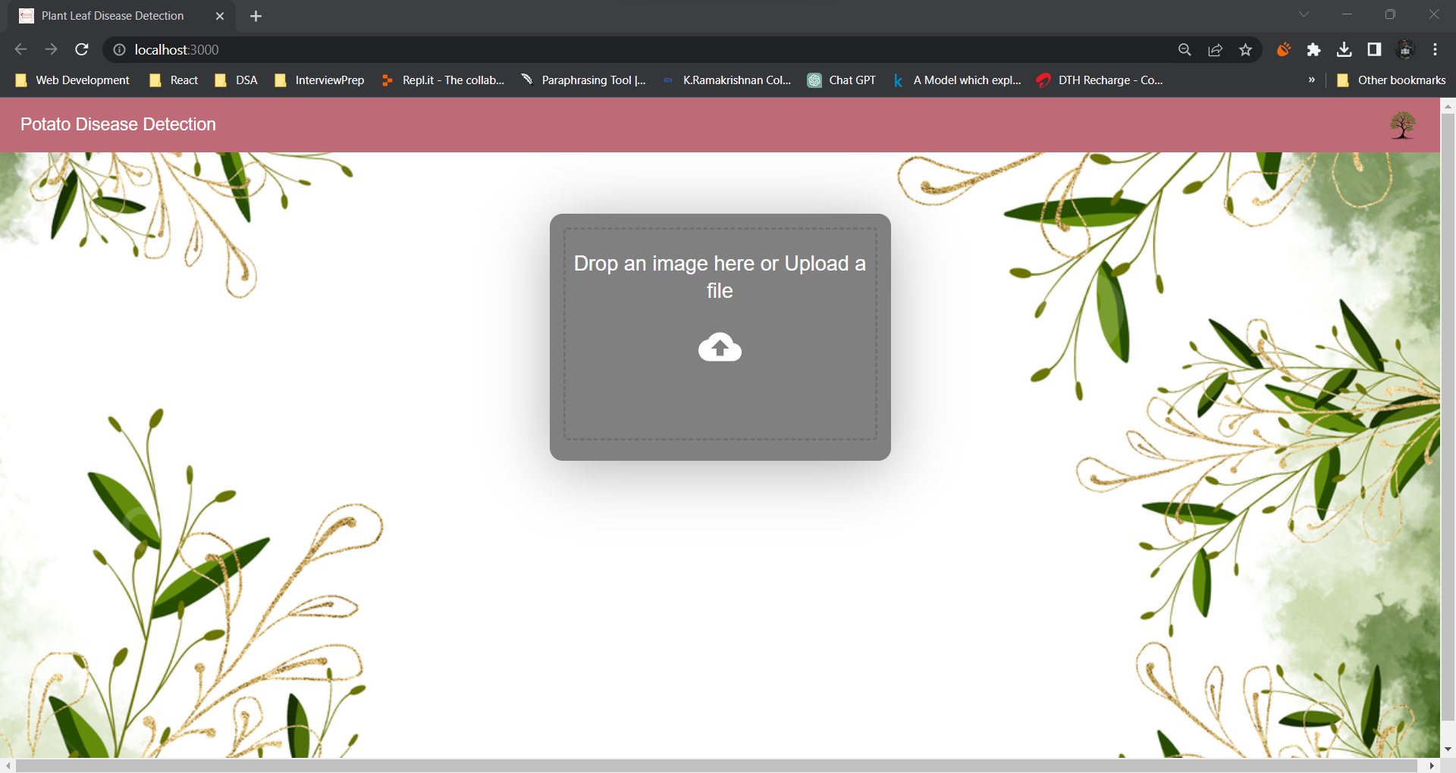
Implementation

Slide 18
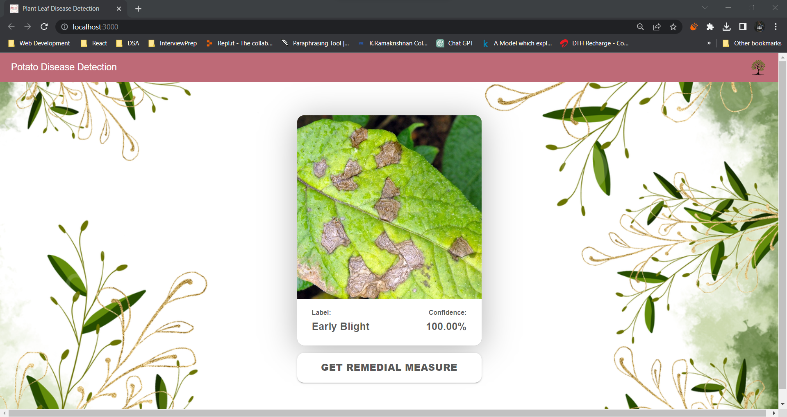
Implementation

Slide 19
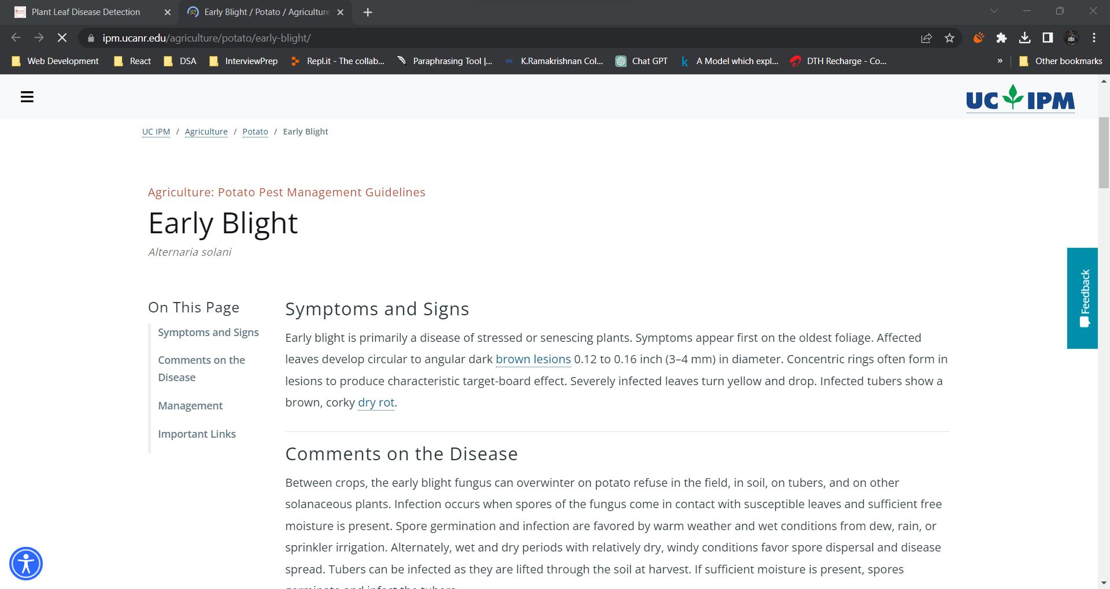
Implementation

Slide 20
Cons
Pros
Our model expected to achieve more than 95% accuracy
Pre-processing steps also contains Caching and shuffling
It reduces human error in identification
It provides remedial measures about the disease.
Difficult to debug and resolve errors in the model.
Requires large amounts of data for training

Slide 21
Future Works
Dataset images can be visualized in training phase
Tensorflow lite model will be developed.
Plant disease detection will be done through a mobile application.

Slide 22

Conference participation proof/Journal publication proof.

Slide 23

Conference participation proof/Journal publication proof.

Slide 24

Conference participation proof/Journal publication proof.

Slide 25
Thank You

